Slide 1
Catalogue of CAP interventions
A way to CAP plans insights
GREX -MONITORING AND EVALUATING THE CAP
11/07/2023
Eduardo Serrano-Padial
DG AGRI – A3 Policy performance

Slide 2
Catalogue of CAP interventions
Why?:
To have an inventory of the CAP interventions in the same language (English) to show all the interventions as planned and described by the Member States and support analysis of the CAP, for officials, farmers, civil society and researchers.
How?
Agri-food Data Portal
Connected to SFC for data reliability and quick update of the information after CAP plans amendments
Content:
Interventions from the most recent version of CAP plans (CSPs). Only validated plans.
One entry per intervention. Interventions are uniquely identified (to the lowest level possible).
Intervention characteristics.
Intervention description in English and Original language
Links to specific objectives (SOs), output and result indicators, sectors, etc.
Budget. Total EU and public expenditure, top-ups and Unit amounts.

Slide 3
How to use it?
Catalogue of CAP interventions
Display and features:
Filters: Member State, Specific objective, Indicators, etc. (more filters to come: sectors, GAEC, territorial scope)
Compact view of results. List of all interventions filtered by the user. Optional columns to be displayed.
Detailed view when selecting a specific intervention. Detailed information about the design of the selected intervention.
Export function. Possibility of exporting search results (e.g. Excel file)

Slide 4
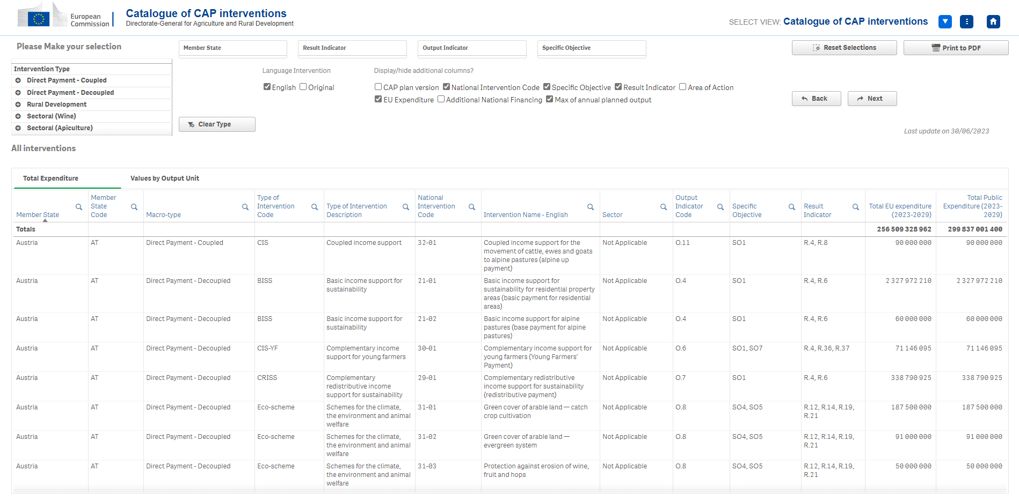
What will you see soon?

Slide 5
Next steps
Catalogue of CAP interventions
Details at Unit amount level and statistics
Labelling of interventions
Precise information on a selected intervention:
Planning by unit amount and by year
Territorial scope
Needs addressed
Statistics. Tables showing main data on interventions (e.g. number of interventions or budget by country or by type specific objective)
Links to JRC’s classification of farm practices - related to environmental objectives
Links to expanded classification with socio-economic categories.

Slide 6
Thank you
© European Union 2020
Unless otherwise noted the reuse of this presentation is authorised under the CC BY 4.0 license. For any use or reproduction of elements that are not owned by the EU, permission may need to be sought directly from the respective right holders.
Slide xx: element concerned, source: e.g. Fotolia.com; Slide xx: element concerned, source: e.g. iStock.com
Notes:
Update/add/delete parts of the copy right notice where appropriate.
More information: https://myintracomm.ec.europa.eu/corp/intellectual-property/Documents/2019_Reuse-guidelines%28CC-BY%29.pdf

